Slide 1
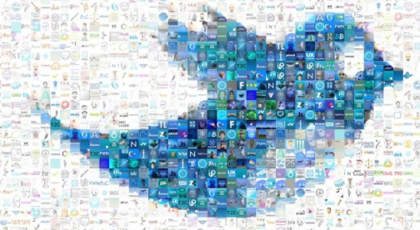
Thinkful Final Capstone NLP: Twitter Sentiment Analysis
Geneson Subra
Feb 2020

Slide 2
Overview
Goal Setting
-Determine the sentiment analysis and scope of work
Data Source
- Twitter API, Tweepy API
- JSON, SQLITE3
Text Processing
- Load Text
- Delete unwanted/ meaningless word
- Sentiment Analysis / text blob / tokenize / sentiment.polarity
Modeling
- Naïve Bayes Classifier
- Text Blob
- SGD
Visualization
- Get geo location for mapping
- Clustering
Final Thoughts and Conclusion
- users geo location
Next Step
- Web App

Slide 3
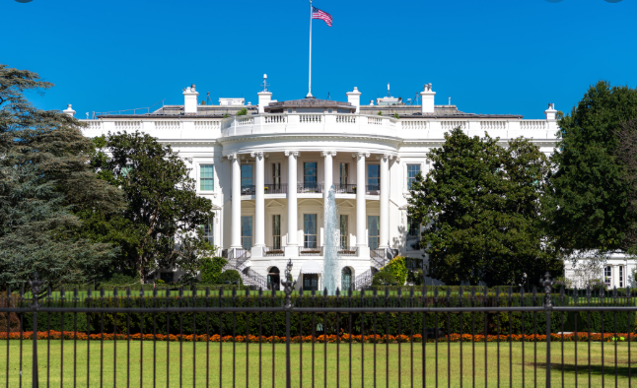
White House

Slide 4
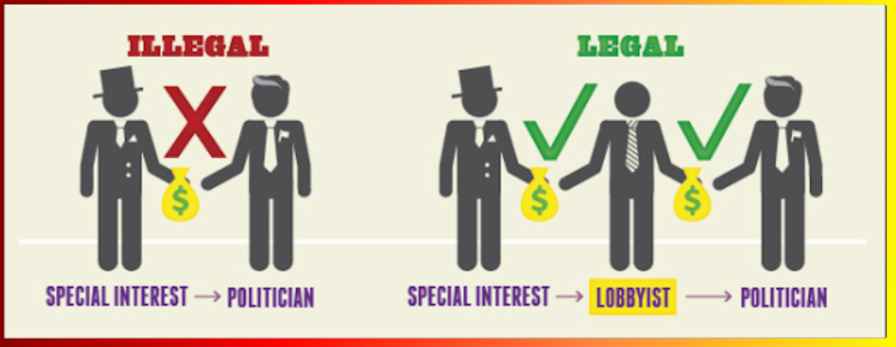
Funding

Slide 5
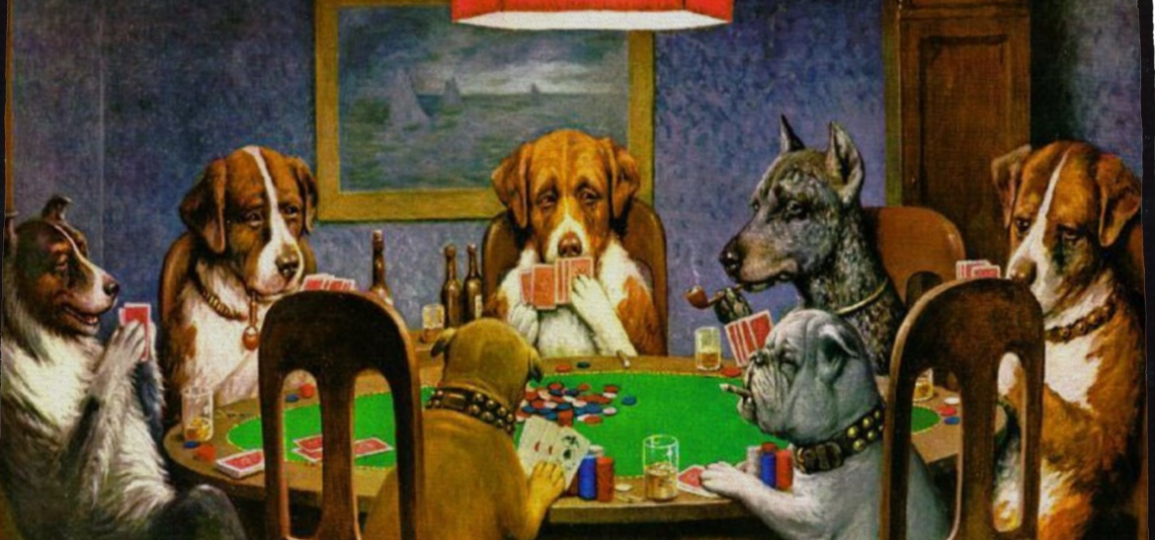
Exploratory Committee

Slide 6
Then What!

Slide 7
Perform market analysis to determine customer sentiment
Politics – Connecting with voters
Product Launch – Consumer Feedback
IPO – favoring the company stock
Decease – preventive measures

Slide 8

consumer_key=‘XXXXXXXXXXXXX', consumer_secret=‘XXXXXXXXXXX’, access_token_key=‘XXXXXXXXXXX’, access_token_secret=‘XXXXXXXXX'
API KEYS
Standard (free ☹)
Premium ($$)
Enterprise ($$)

Slide 9
Data Storage
Storage
● SQLITE3
● JSON

Slide 10
Text pre-processing - clean tweets - remove links - special characters - lowercase

Slide 11
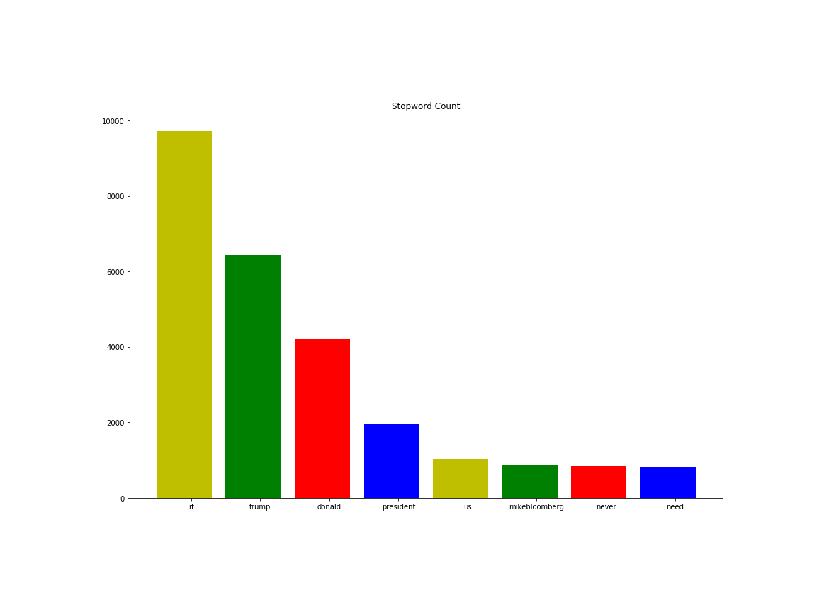
Data Exploration
Common words found in the
tweets

Slide 12
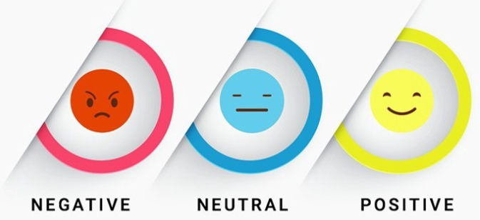
TextBlob
python library and offers a simple API
We only considering positive and negative sentiments
Text Blob do not provides a score, however, it provides sentiment polarity

Slide 13
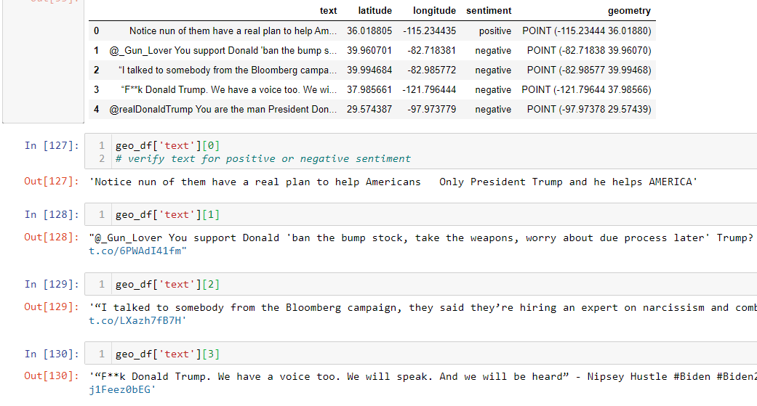

Slide 14
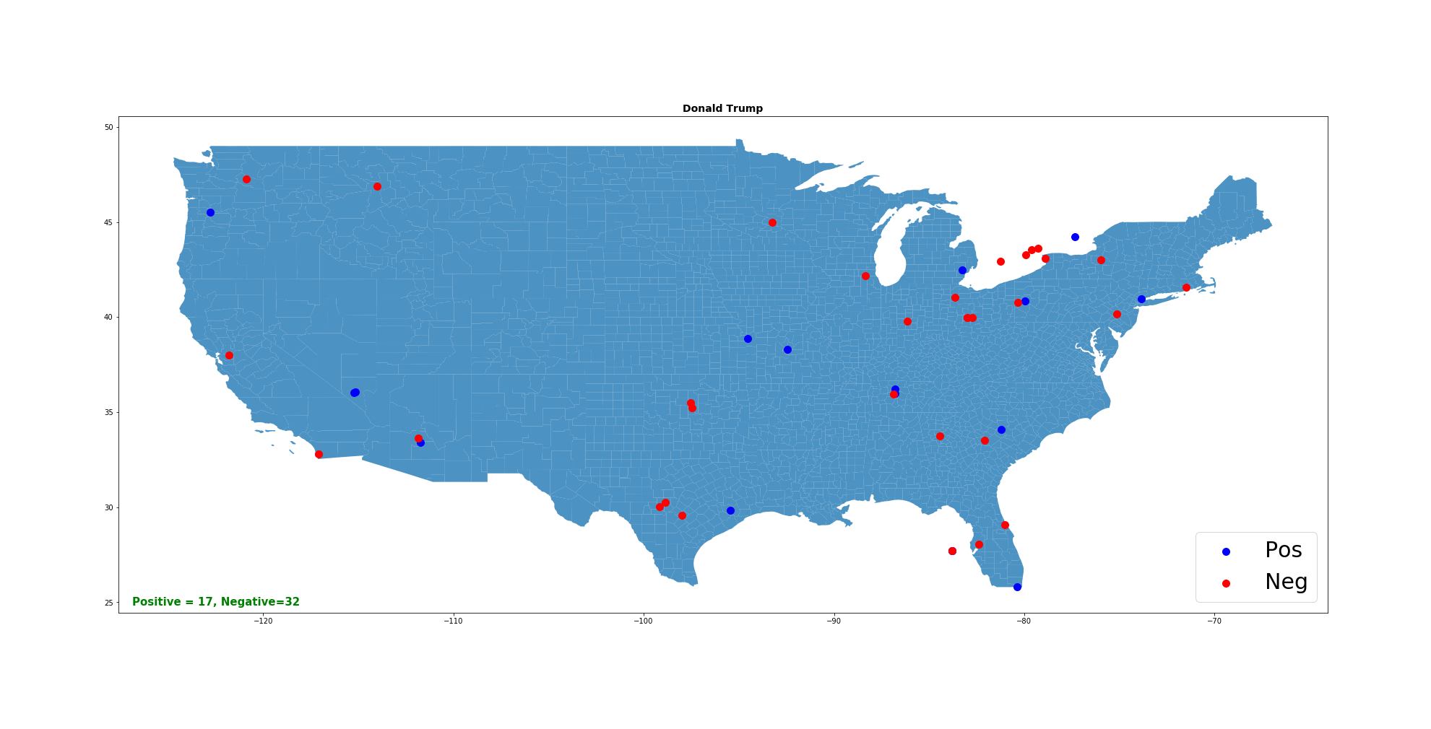

Slide 15
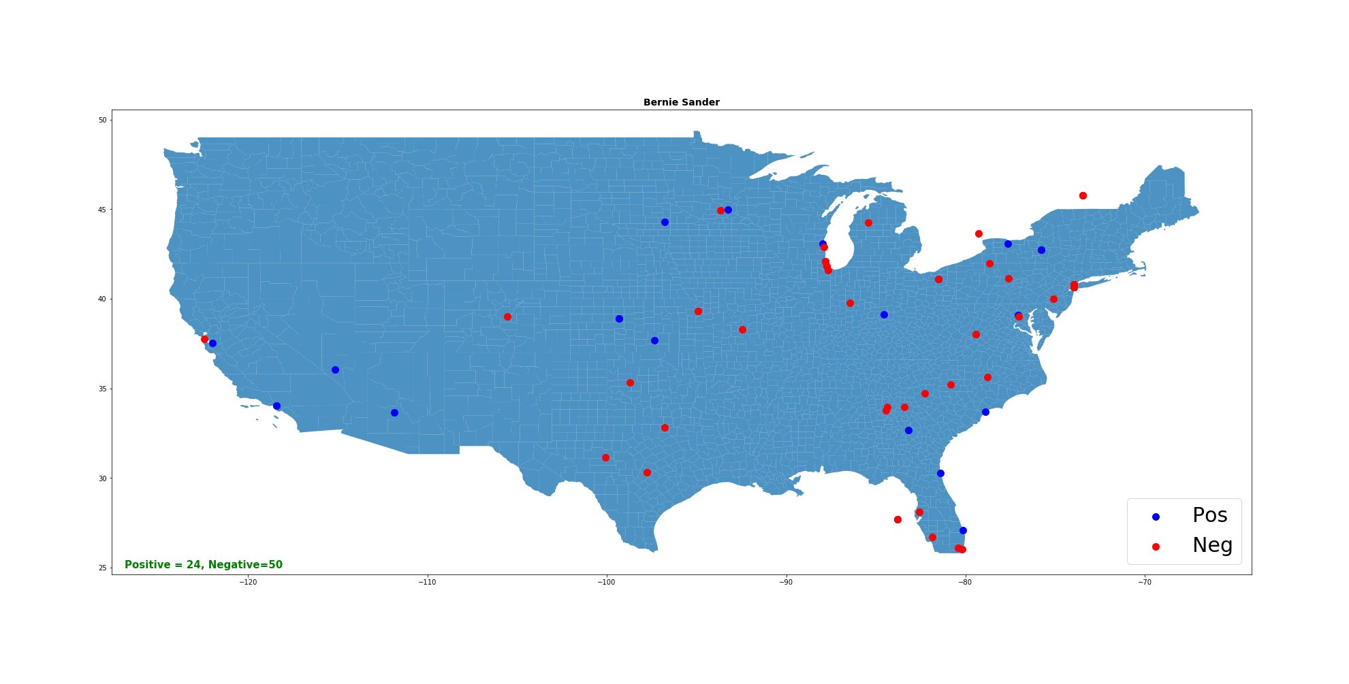

Slide 16


Slide 17
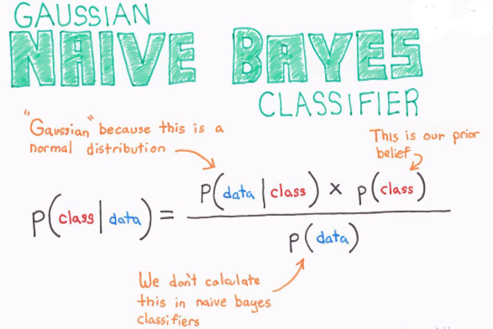
Model Selection Train the model with a labeled dataset that I found on GitHub. https://datahack.analyticsvidhya.com/contest/practice-problem-twitter-sentiment-analysis/
Naïve Bayes
Polarity: Positive & Negative

Slide 18
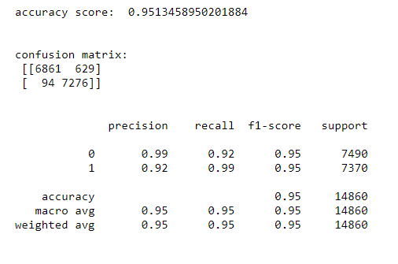
Model Selection
Naïve Bayes

Slide 19
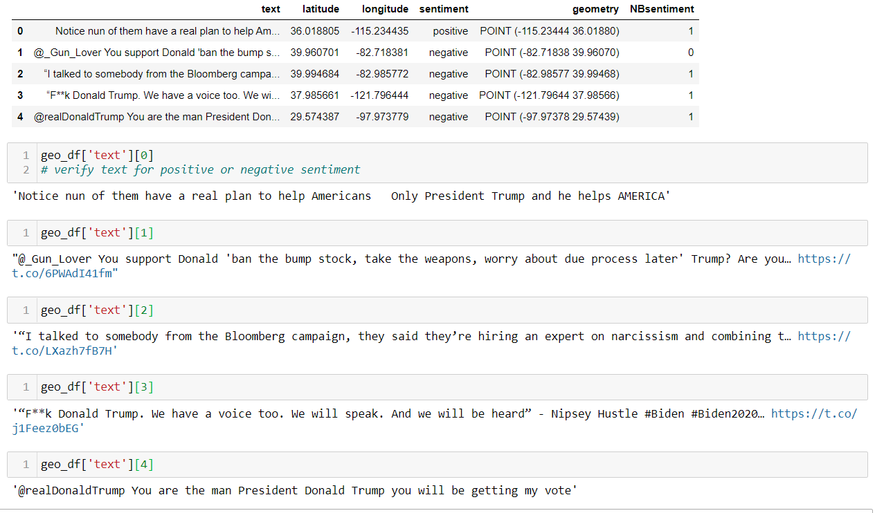

Slide 20


Slide 21


Slide 22


Slide 23
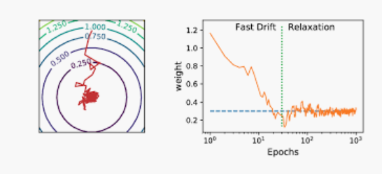
Stochastic Gradient Descent with default settings
Model

Slide 24
Bag of Words = BoW assign weight proportional to word frequency
Sci-kit learn built in functions:
● CountVectoriser - tokenize ( split & frequency count)
● TfidfTransformer – apply the frequency weight

Slide 25
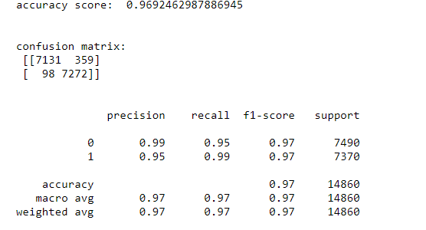

Slide 26
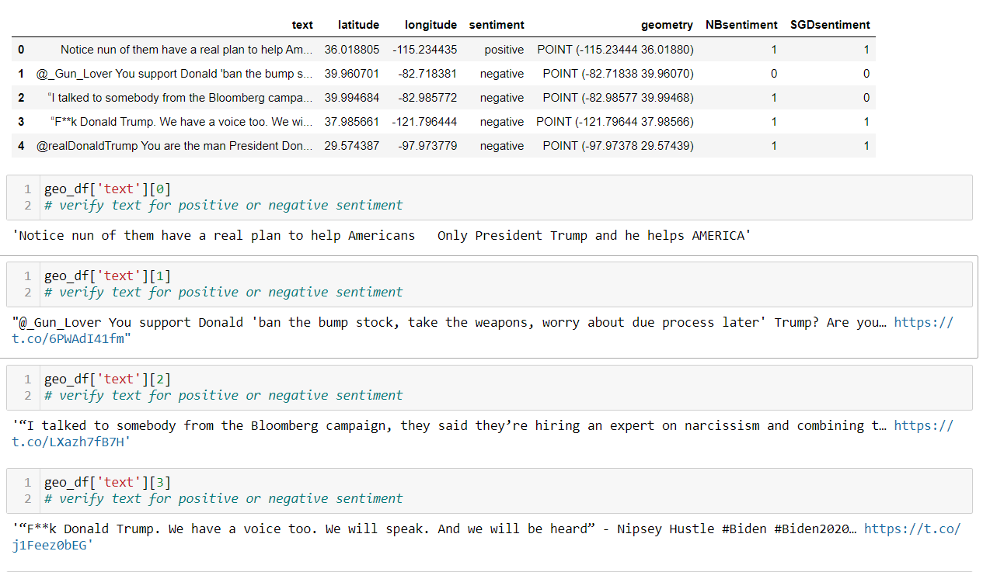

Slide 27


Slide 28


Slide 29


Slide 30
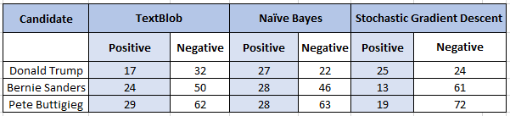

Slide 31
T-SNE Clustering
Found a code: https://www.kaggle.com/ahmedsmara/visualizing-word-embedding-using-t-sne
● visualize
● find patterns

Slide 32
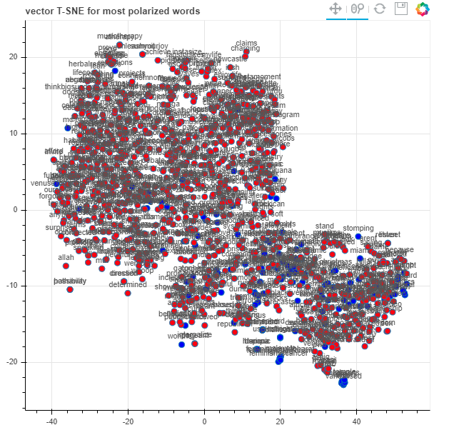

Slide 33
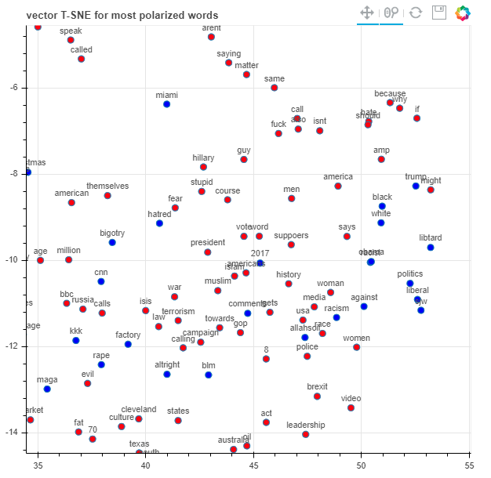

Slide 34
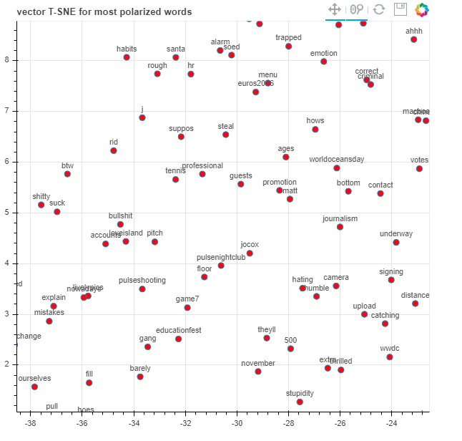

Slide 35
Other Factors: - Sarcasm - Potty words
What ML is good at?

Slide 36

Practical Use
Who can benefit from this predictions
Product Launch – Consumer Feedback
IPO – favoring the company stock
Disease – preventive measures

Slide 37
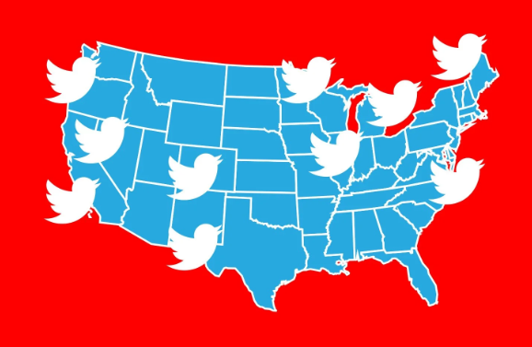
Caution
Geo location enabled

Slide 38
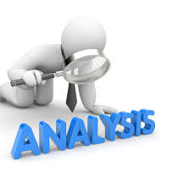
Further Data Analysis:
Use more data to enrich the geo-map
Web Interface

